Slide 1

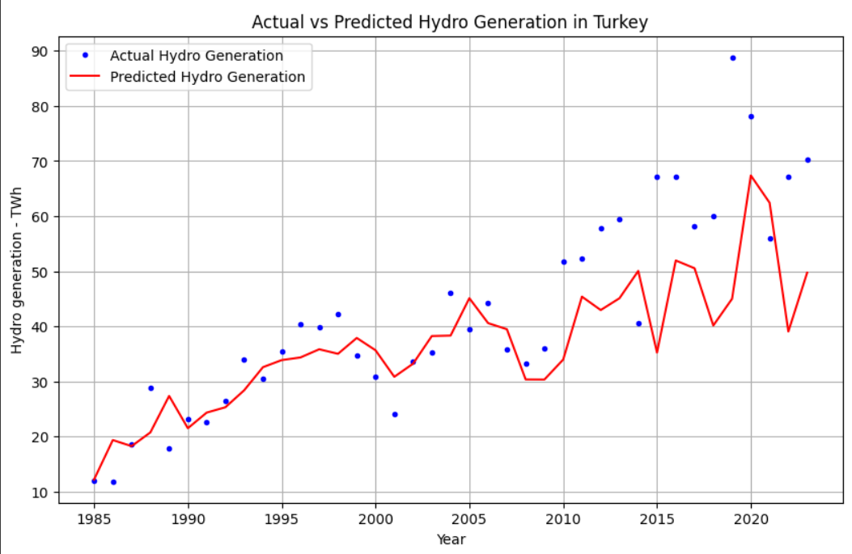
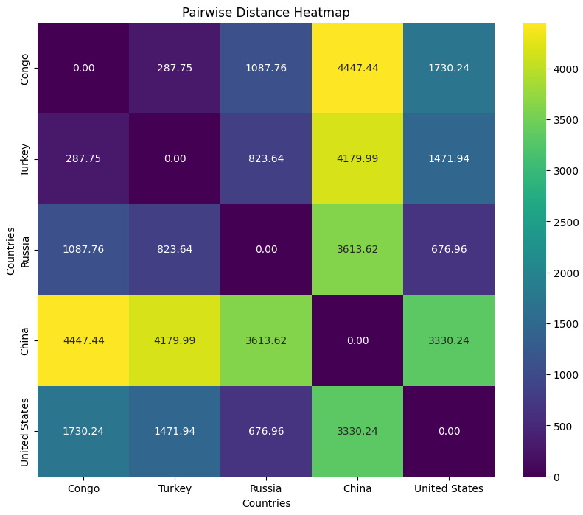
1. ISTANBUL NIŞANTAŞI UNIVERSITY
DATA MINING COURSE PROJECT EXHIBITION 2024
30 MAY 2024
Renewable Energy Production
PROJECT TEAM
Name surname: Abdelrahman Elorabi - 20202022103
Name surname: Youssef Hassan - 20212022103
Name surname: Ahmad Al-Hashmi - 20202022115
Project Supervisor: Dr. Nesibe Manav
ABSTRACT
The study investigates energy consumption and production trends across five countries—United States, China, Democratic Republic of Congo, Russia, and Turkey—focusing on renewable energy adoption. Using data mining techniques, the report predicts hydro energy production through linear regression and categorizes countries based on hydro energy patterns using K-Means clustering. Notably, the United Nations’ Sustainable Development Goal 7 (Affordable and Clean Energy) guides this analysis. Results reveal varying prediction accuracy and distinct hydro energy production characteristics among the countries.
INTRODUCTION
MATERIALS AND METHODS
In this study, we utilized data mining techniques to predict hydro energy production and classify countries based on their hydro energy production patterns.
1- Forecasting (linear regression) Hydro Energy Production:
We used a linear regression model to predict future hydro energy production, with population and per capita energy consumption as predictors. The dataset was divided into 60% for training and 30% for testing.
Evaluation point:
Congo: MSE = 0.000601967345567091 TWh
Turkey: MSE = 369.6665475062212 TWh
Russia: MSE = 108.4472268609678 TWh
China: MSE = 119783.94651730628 TWh
United States: MSE = 4494.668659011812 TWh
2- k-means Clustering Analysis:
To identify similarities among countries based on hydro energy production characteristics, we applied the K-Means clustering algorithm with 𝑘=3k=3. The clustering aimed to categorize countries into three distinct groups. Evaluation matrices:
Inertia: 270539.6114911528, indicating a moderate level of compactness within clusters.
Silhouette Score: 0.4827845130479176, suggesting reasonably well-defined clusters with good separation.
Davies-Bouldin Index: 0.28525803757558893, implying well-separated clusters with a good overall structure.
The report delves into the importance of energy in powering essential aspects of modern life, such as lighting, transportation, and heating. It primarily examines global energy production and consumption trends, with a focus on clean energy initiatives in various countries. Additionally, it discusses pollution-related death rates, public awareness, and changes in individual energy consumption from 1985 to 2023. The report aims to highlight differences in energy usage among selected countries while assessing their progress towards adopting renewable energy sources.
By selecting five countries, the United States, China, the Democratic Republic of Congo, Russia, and Turkey, the report aims to highlight the divergence in consumption and production rates of energy and how each country tends to obtain renewable energy. This examination is conducted under the light of one of the United Nations' 17 Sustainable Development Goals, specifically Goal 7: Affordable and Clean Energy
CONCLUSION AND RECOMMENDATIONS
The report examines the differences in energy consumption and production rates among five countries— the United States, China, the Democratic Republic of Congo, Russia, and Turkey—highlighting their approaches to renewable energy under the United Nations' Sustainable Development Goal 7: Affordable and Clean Energy. Using data mining techniques, the study employs a linear regression model to forecast hydro energy production based on population and per capita consumption, and a K-Means clustering algorithm to categorize countries by their hydro energy production patterns. The linear regression model showed varying prediction accuracy, with the Mean Squared Error ranging from very low for Congo to extremely high for China. The K-Means clustering analysis, with three clusters, revealed distinct groupings with moderate compactness and good separation, indicating varied hydro energy production characteristics among the countries.
REFERENCES
1- Evaluation of renewable energy policies in Turkey with sectoral electricity demand forecasting Fatih Soğukpınar1,2 · Gökhan Erkal1 · Hüseyin Özer1
2- Ember - Yearly Electricity Data (2023); Ember - European Electricity Review (2022); Energy Institute - Statistical Review of WorldEnergy (2023) – Learn more about this data
3- Max Roser (2021) - “Energy poverty and indoor air pollution: a problem as old as humanity that we can end within our lifetime”

